Slide 1
Chapter-1 Contents
Summarizing Data Sets : Histograms
Summarizing Data Sets : Mean
Summarizing Data Sets : Variance
Percentile
Quartiles and Box Plots
Normal Data Sets Histograms / Distributions & Outliers
Correlation = strength of an assumed linear relationship

Slide 2
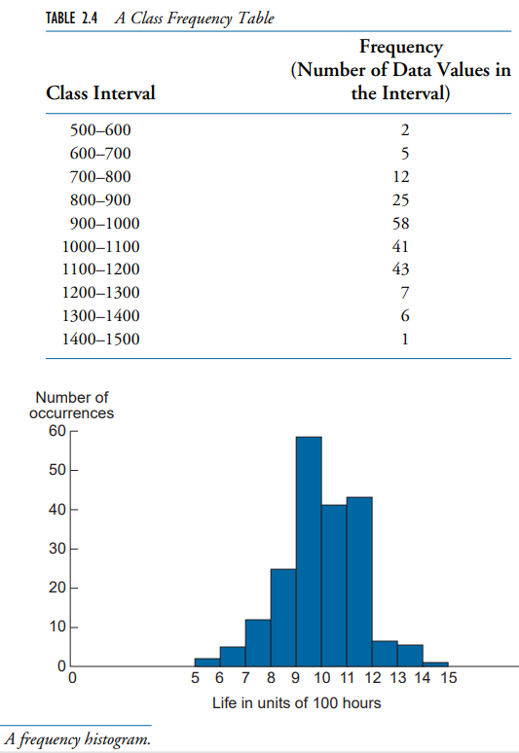
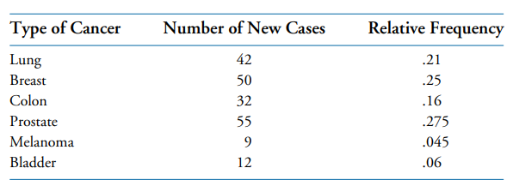
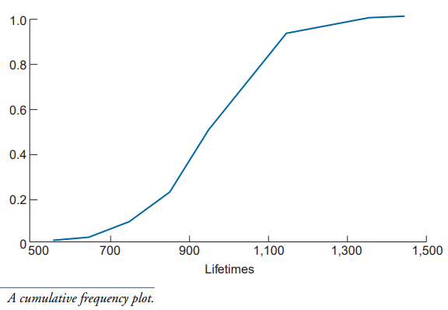
Summarizing Data Sets : Histograms
1.1
Relative frequency = Probability density (sums to 1)
For continuous values, bin into discrete buckets
Probability density function
(PDF)
Cumulative density function
(CDF)

Slide 3
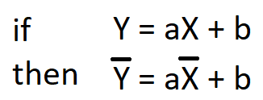
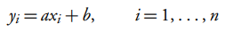
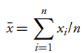
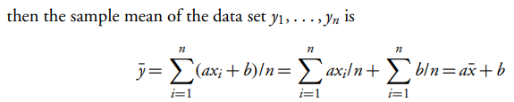
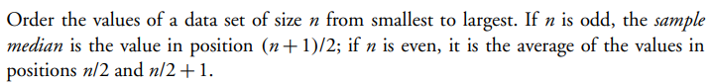
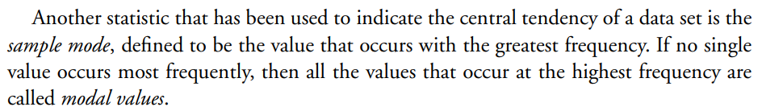
Summarizing Data Sets : Mean
1.2
Sample Mean, Sample Median, Sample Mode
if
Sample Mean
Sample mean is NOT population mean !
e.g., Voter exit polls are only a sample mean intended to representation of the overall population mean, but is not the population mean
Median
Median = (25+175)/2 = 100
Median
8 | 15 | 50 | 200 | 1000
1 | 3 | 25 | 175 | 880 | 9999
Mode
Most Frequent Value(s)

Slide 4
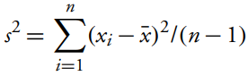
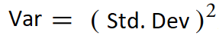
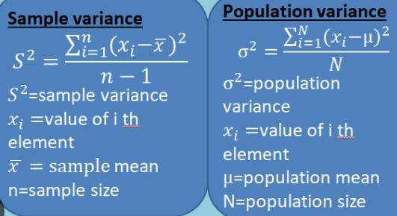
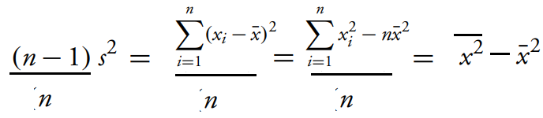
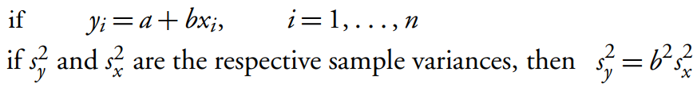
Summarizing Data Sets : Variance
1.3
Sample Variance and Standard Deviation, vs
Population Variance and Std. Dev
Like sample mean is not population mean, Sample Variance != Population Variance
Like sample mean is an estimate/approximation of the population mean, similarly sample variance is an estimate of the population variance.
Sampling is done when it is not feasible to access/process the whole population.
An Algebraic Identity
Variance of Translated variable

Slide 5
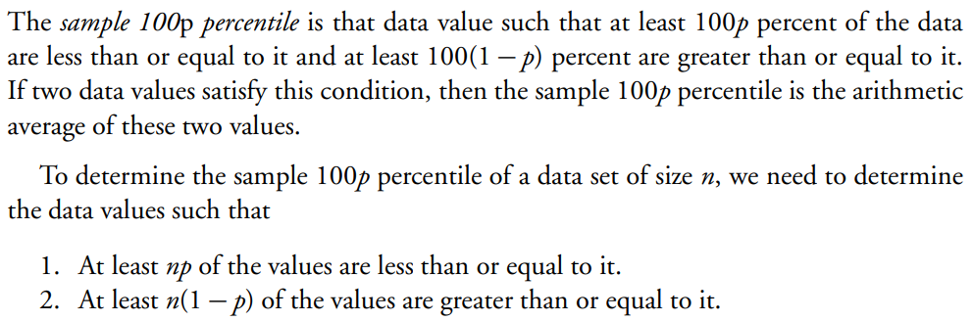
Percentile
1.4
If you score 99 percentile in an exam. It is not that you scored 99 % (percent).
It means that 99% of people scored <= you and 1% people score >= you
Deciles
Arranging a set of data points in deciles means:
Sort the data points in increasing order,
Distribute them in 10 bins in increasing order such that each bucket contains equal number of data points (10% in each bin). These bins are the deciles, e.g:
1 | 3 | 4 | 8 | 10 | 14 | 15 | 16 | 20 | 25 | 28 | 30 | 32 | 35 | 40 | 50 | 55 | 60 | 70 | 99
decile 1 |  | decile 2 |  | decile 3 |  | decile 4 |  | decile 5 |  | decile 6 |  | decile 7 |  | decile 8 |  | decile 9 |  | decile 10

Slide 6
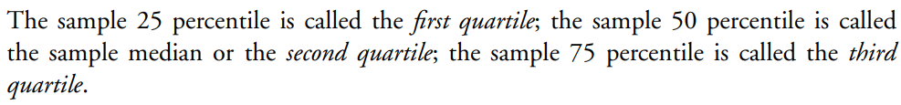
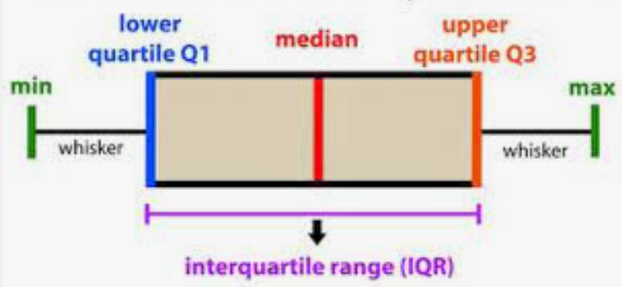
Quartiles and Box Plots
1.5
Box plot shows the min, 1st 2nd 3rd quartiles, and max values.
1st quartile = 25 percentile, 2nd quartile = 50 percentile = median, 3rd quartile = 75 percentile
Box plot shows the skewness in data
Also plot the mean in the box-plot. This gives a better view of the skew
The length of the line segment on the box plot, equal to the largest minus the smallest data value, is called the range of the data.
the length of the box itself, equal to the third quartile minus the first quartile, is called the interquartile range.
Box Plot

Slide 7
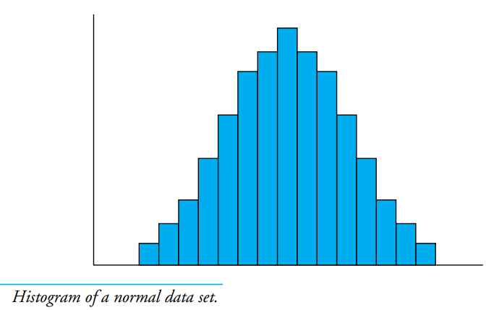
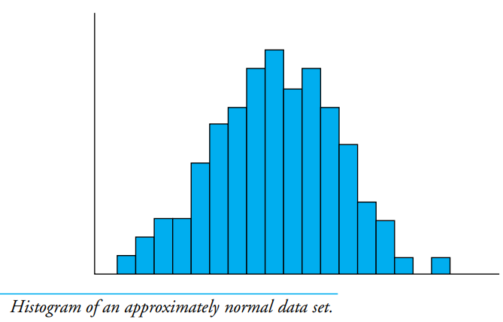
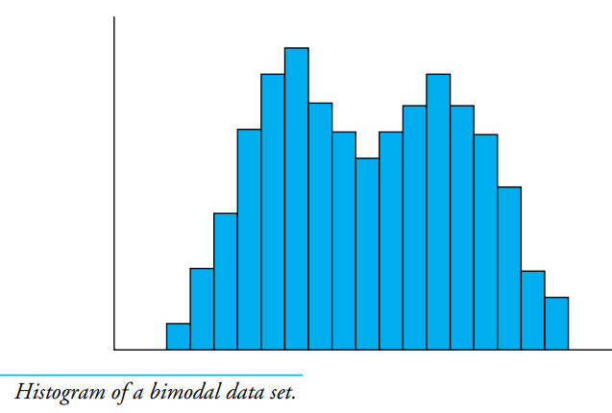
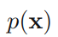
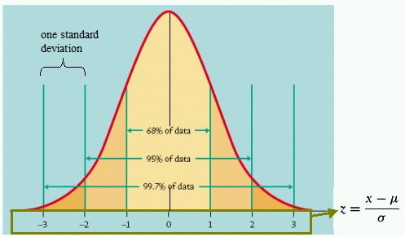
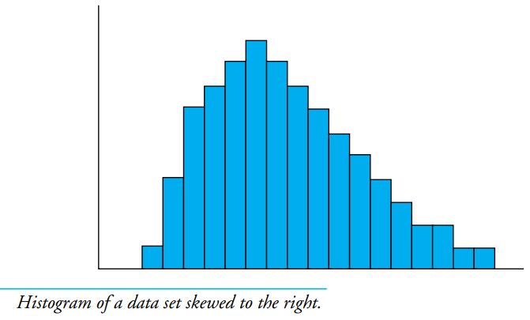
Normal Data Sets Histograms / Distributions & Outliers
1.6
Many of the large data sets observed in practice have histograms that are similar in shape. These histograms often reach their peaks at the sample median and then decrease on both sides of this point in a bell-shaped symmetric fashion. Such data sets are said to be Normal and their histograms are called Normal histograms
Normal / Gaussian Distribution
Bimodal Data ~ mixture of distributions
p(x) = relative frequency
mean
median
Z – score = how many StDev away is a point from its mean
If z > 3, it maybe an outlier
Z > 3: outlier

Slide 8
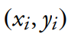
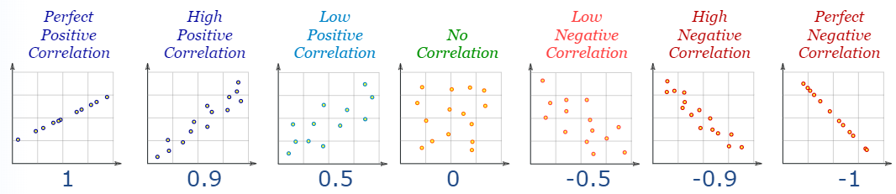
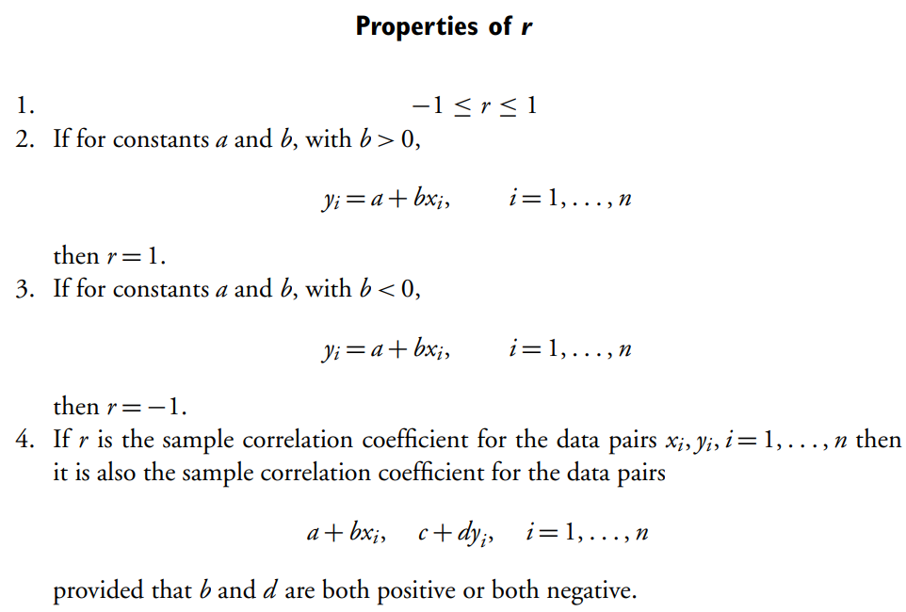
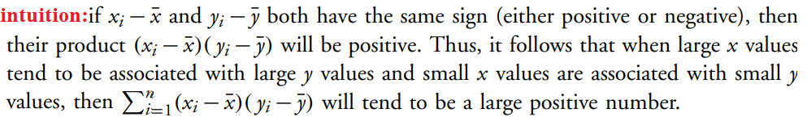
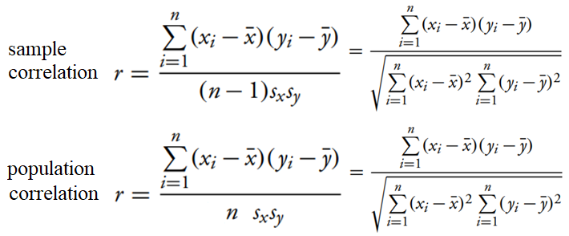
Correlation = strength of an assumed linear relationship
1.7
Assumes and measures strength of linear relationship between two variables. Measures Association, not Causation
An e.g., application: Features which are more correlated to the Target are more important. Fix all features at their mean except one, vary this by 1-sd and measure variation in target. The feature causing more variation in the Target is the more important one.

Slide 9
Chapter-2 Contents
Joint, marginal, conditional probability distribution
Three Laws of Probability
Expectation of f(x) where x has PDF p(x)
Point Estimates: Max Likelihood (MLE) vs Max Posterior (MAPE)
Covariance between bi-variates (x, y) as matrix operation
Covariance among multi-variates
Summary: Probability Densities, expectation, variance, covariance, correlation

Slide 10
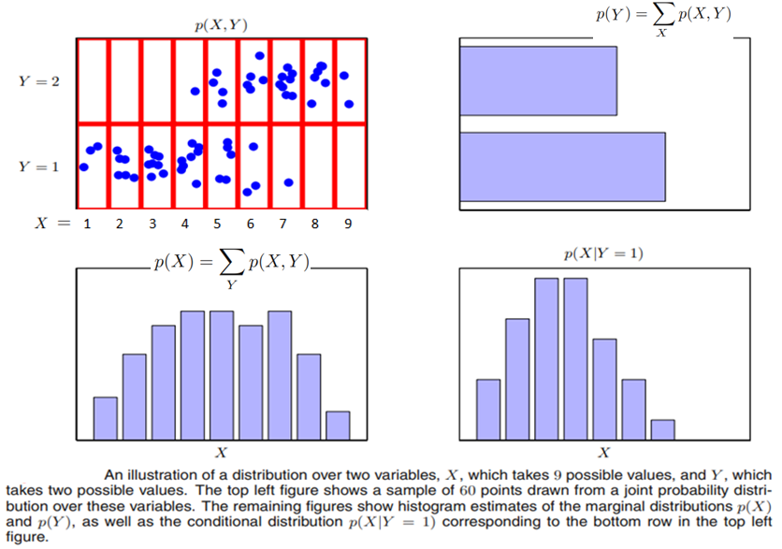
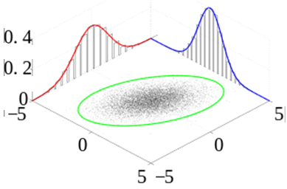
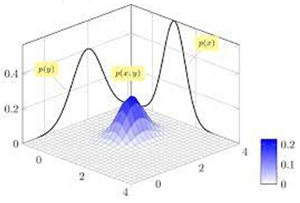
Joint, marginal, conditional probability distribution
2.1
Multivariate data – joint probability distribution e.g., p(x,y). (e.g., used for anomaly detection)
Integrate the joint probability distribution to get marginal probability distribution e.g., p(x)
marginal prob.
Outlier / Anomaly
joint prob.
0
0
0
1
4
5
8
5
2
Note: p(x=9) > 0 p(y=1) > 0 but
p(x=9, y=1) = 0 !
0/60+0/60+0/60+1/60+4/60+5/60+8/60+5/60+2/60 = 25/60
N=60
3/60+6/60+8/60+9/60+5/60+3/60+1/60+0/60+0/60 = 35/60
X
Y
3
6
8
9
5
3
1
0
0
marginal prob.
conditional prob.
Marginal Prob. Distbn. P(x), P(y)
Joint Prob. Distbn. P(x,y)
9/60
+
1/60
8/60
+
1/60
8/35
9/35
8/60
+
0
5/60
+
4/60
6/35
3/60
+
5/60
5/35
6/60
+
0
5/60
+
0
3/35
3/35
3/60
+
0
2/60
+
0
1/35
0/35
0/35
X
Y

Slide 11
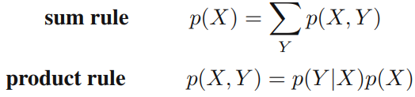
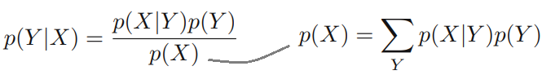
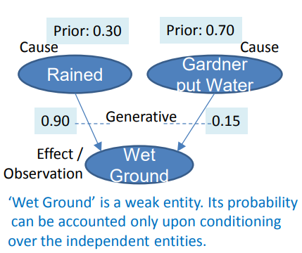
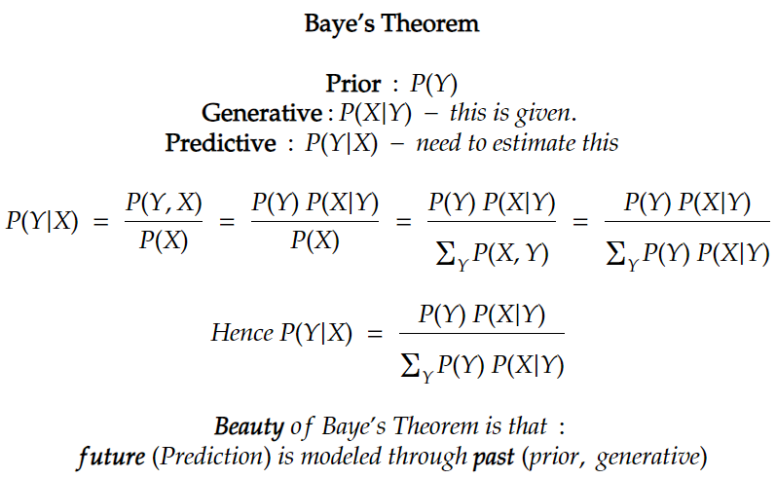
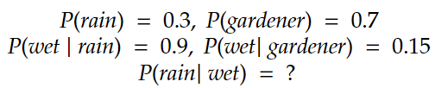
Three Laws of Probability
2.2
Sum rule and Product rule
Baye’s Theorem

Slide 12
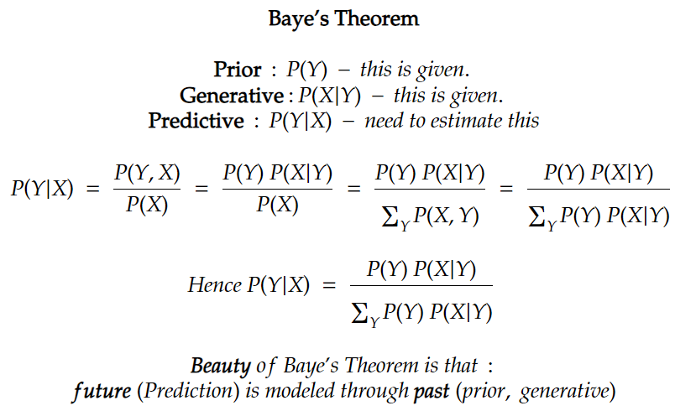
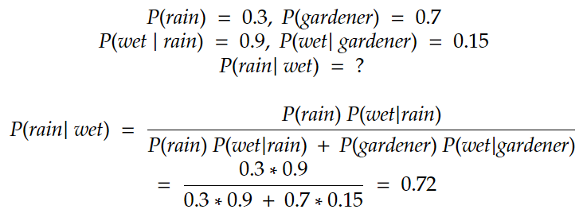
Three Laws of Probability: question-1
2.2
Sum rule and Product rule
Baye’s Theorem

Slide 13
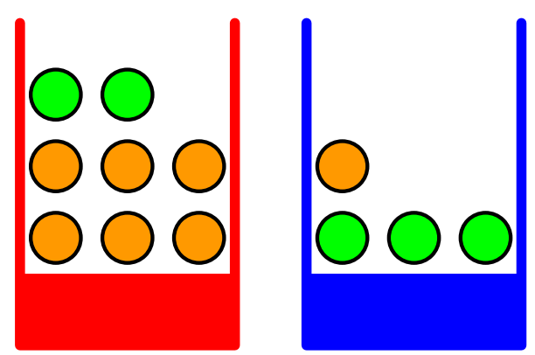
Three Laws of Probability : question-2
2.2
Sum rule and Product rule
Baye’s Theorem
Given a red and blue box. Red box has 2 apples & 6 oranges. Blue box has 3 apples and 1 orange. Your eyes are closed and you have to pick any fruit. Blue box is bigger in size hance probability of selecting blue-box is 0.6. Problem:
What is probability to pick an apple ?
If an orange is picked, what is prob. if the box is red ?
Total #apple = 5
Total #Fruits = 12
Hence p(apple) = 5/12 ? – No, this is Wrong

Slide 14
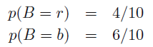
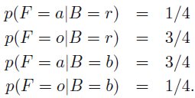
Three Laws of Probability : question-2
2.2
Sum rule and Product rule
Baye’s Theorem
Given a red and blue box. Red box has 2 apples & 6 oranges. Blue box has 3 apples and 1 orange. Your eyes are closed and you have to pick any fruit. Blue box is bigger in size hance probability of selecting blue-box is 0.6. Problem:
What is probability to pick an apple ?
If an orange is picked, what is prob. if the box is red ?
Random Vars
Given
B (Box):
r = red
b = blue
F (Fruit):
a = apple (green color)
o = orange (orange color)
Total #apple = 5
Total #Fruits = 12
Hence p(apple) = 5/12 ? – No, this is Wrong

Slide 15
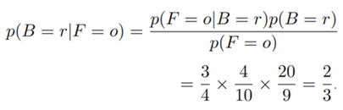
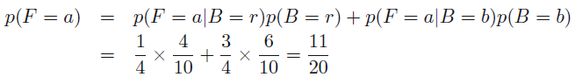
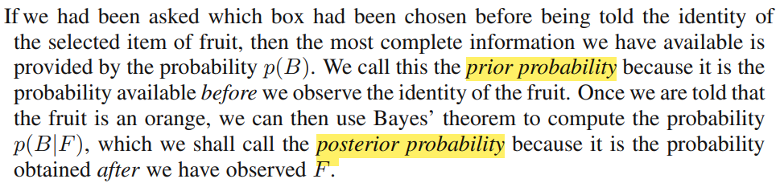
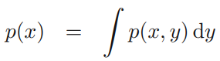
Three Laws of Probability : question-2
2.2
Sum rule and Product rule
Baye’s Theorem
Given a red and blue box. Red box has 2 apples & 6 oranges. Blue box has 3 apples and 1 orange. Your eyes are closed and you have to pick any fruit. Blue box is bigger in size hance probability of selecting blue-box is 0.6. Problem:
What is probability to pick an apple ?
If an orange is picked, what is prob. if the box is red ?
Random Vars
Given
B (Box):
r = red
b = blue
F (Fruit):
a = apple (green color)
o = orange (orange color)
Total #apple = 5
Total #Fruits = 12
Hence p(apple) = 5/12 ? – No, this is Wrong
P (F = a) = ?
P (B = r | F = o) = ?
: Sum Rule
: Baye’s Theorem
: Product
Rule
= 0.55
P (F = o) = 1 – P (F = a) = 9/20
= 0.45
Posterior P(B=r|F=o) is higher even when prior P(B=b) is higher!
If continuous vars

Slide 16
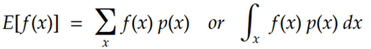
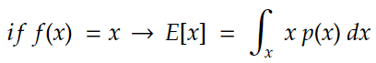
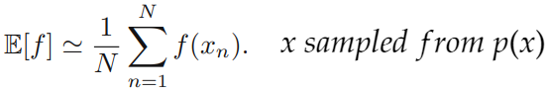
Expectation of f(x) where x has PDF p(x)
2.3
A person can walk max. up to 10 km. Probability that a person walks a distance of x km. is proportional to x.
What is the expected distance a person walks ?

Slide 17
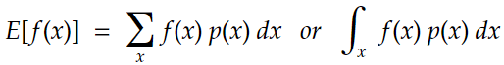
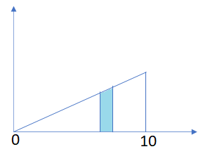


Expectation of f(x) where x has PDF p(x): question-1
2.3
A person can walk max. up to 10 km. Probability that a person walks a distance of x km is proportional to x.
What is the expected distance a person walks ?
p(x)
p(x) = k x : 0 <= x <= 10
p(x) = 0 : 10 < x
p(x)dx
x

Slide 18



Point Estimates: Max Likelihood (MLE) vs Max Posterior (MAPE) Estimate
2.4
MLE: An estimate which maximizes the likelihood of the observation.
MAPE: Models the posterior probability distribution.
Prob( P(Heads) = p )
But can you predict a probability distribution for P(Heads) and suggest confidence intervals ?
sd
sd
sd
sd
P(Heads)

Slide 19


Point Estimates: Max Likelihood (MLE) vs Max Posterior (MAPE) Estimate: question
2.4
MLE: An estimate which maximizes the likelihood of the observation.
MAPE: Models the posterior probability distribution.
MAPE: the point p at which this is maximized. In this case MAPE estimate is same as MLE: K/N
MAPE

Slide 20







Covariance between bi-variates (x, y) as matrix operation
2.5
Covariance between variables (x, y): and variance :
X | Y
X1 | Y1
X2 | Y2
X3 | Y3
… | …
Xn | Yn
Covariance
Matrix =

Slide 21



Covariance among multi-variates say W = [x, y, z] is
2.6

Slide 22















Summary: Probability Densities, expectation, variance, covariance, correlation
2.7
Important to get a hang of Expectation, Variance, Covariance, Correlation
Probability distribution/density properties
Expected value of f(x)
Variance of f(x)
If x independent y:
Covariance
Correlation

Slide 23
Chapter-3 Contents
Special Random Variables: Uniform and Normal RVs
Uniform Random Variable: Max. Likelihood Estimate (MLE) example
Special Random Variables: Chi-Square, t-Distribution, F-Distribution
Distributions of Sampling Statistics

Slide 24






Special Random Variables: Uniform and Normal RVs
3.1
Define Randomness: randomness is a probability distribution (think histogram) e.g.:
Uniform randomness, Gaussian/Normal Randomness, etc..
Joint uniform distribution

Slide 25
Uniform Random Variable: Max. Likelihood Estimate (MLE)
3.2
What is some param (e.g. mean) 𝜃 of a given population distribution when some samples from that population are observed ?
Maximum Likelihood Estimate of 𝜃 = that value which maximizes the likelihood of the observations.

Slide 26

Uniform Random Variable: Max. Likelihood Estimate (MLE): question-1
3.2
What is some param (e.g. mean) 𝜃 of a given population distribution when some samples from that population are observed ?
Maximum Likelihood Estimate of 𝜃 = that value which maximizes the likelihood of the observations.
p(x) = 1/ θ
θ
x

Slide 27









Special Random Variables: Chi-Square, t-Distribution, F-Distribution
3.3
Some distributions are 1-sided (x>=0), some are 2-sided

Slide 28











Distributions of Sampling Statistics
3.4
Sample mean is a point estimate of the population mean. Sample mean is a random variable
Properties of Mean
Densities of sample means from a std. normal population
A general rule of thumb is that one can be confident of the normal approximation whenever the sample size n is at least 30.
Properties of Variance
Binomial Distribution

Slide 29
Chapter-4 Contents
Interval Estimate (Confidence Interval) for population mean
Point Estimate (MLE) vs Interval Estimate (Confidence Interval)
Two-sided and one-sided Confidence Interval
Distributions of Sampling Statistics
Parameter Estimation
Hypothesis Testing

Slide 30





Interval Estimate (Confidence Interval) for population mean
4.1
If we do sampling multiple times, each time the sample mean maybe different. This tells that the sample mean is a random var and 95% times actual population mean will lie within 1.96*Stdev of sample mean.
X_1 | X_2 | X_2 | ….. | X_n
.....
X_1 | X_2 | X_2 | ….. | X_n
.....
X_1 | X_2 | X_2 | ….. | X_n
Z-score
Suppose the red dot is the only observed value.
Then the red range is the 95% confidence interval estimate:
If the observation (red dot) is in the critical region: reject H_0, else accept it.
Critical region
Critical region
Confidence interval
Confidence interval

Slide 31



Point Estimate (MLE) vs Interval Estimate (Confidence Interval)
4.2
Two-sided confidence interval assuming stdev is known.

Slide 32



Two-sided and one-sided Confidence Interval
4.3
Two-sided vs. one-sided confidence interval assuming stdev is known.

Slide 33
Chapter-5 Contents
Hypothesis Testing
Known variance: Normal Distbn., Unknown variance: T-Distribution
Testing equality of means of two Normal populations
Tests comparing the Variance of populations

Slide 34








Hypothesis Testing
5.1
Normal distribution with known variance
One sided test

Slide 35






Known variance: Normal Distbn., Unknown variance: T-Distribution
5.2
Reject null hypothesis if p-value < α (level of significance)
Smaller the p-value worse the fit
hence
is t-distribution with n-1 degrees of freedom

Slide 36






Testing equality of means of two Normal populations
5.3
Paired t-test can work even if the two populations are not independent and have different variances.
Separate tests for i) known variance, ii) unknown but equal variance, iii) unknown, unequal variance.
normal population having unknown mean and unknown variance

Slide 37




Tests comparing the Variance of populations
5.4

Slide 38
Chapter-6 Contents
One way - Analysis of Variance (ANOVA)
Chi-squared test – test independence of two categorical columns

Slide 39















One way - Analysis of Variance (ANOVA)
6.1
Get two estimates of variance: i. When assuming all group means are same, ii. irrespective of the group means being same or not. If they differ much then the group means are not same.
expected value of a chi-square random variable is equal to its number of degrees of freedom
Let
Let
then
1 degree of freedom is lost for each parameter that is estimated
Sum of squares of n*m std norm vars is chi^2 with n*m degrees of freedom
Let
then
or
irrespective of H0 being true or not
hence
Let

Slide 40



One way - Analysis of Variance (ANOVA)
6.1
H0: all group means are same. i. Calculate the test statistic and p-value.
ii. Reject H0 if p-value < 0.05 (95% confidence interval)

Slide 41





Chi-squared test – test independence of two categorical columns
6.2
H_0: X and Y are independent. If H_0 is rejected, we conclude that the two columns are dependent/correlated. Hence columns with minimum p-values are the most important ones!
X | Y
1 | 9
1 | 8
1 | 9
2 | 6
3 | 3
3 | 6
4 | 8
… | …

Slide 42


Chi-squared test – test independence of two categorical columns: question-1
6.2
Question: is gender independent of political affiliation ?

Slide 43





Chi-squared test – test independence of two categorical columns : question-1
6.2
Question: is gender independent of political affiliation ?
Answer: No, political affiliation is dependent on gender.

Slide 44
Chapter-7 Contents
Linear regression (linear in weights)
MLE solution: Moore Penrose pseudo inverse – Least square approximation
Evaluation: R^2 - higher the better
Gradient Descent : 1st order approximation of Taylor’s theorem
Sequential Gradient Descent Optimization
Regularized Least Squares Error (weight decay)
Underfitting and Overfitting
Bootstrap Aggregation (Bagging) – reduces both Bias and Variance
Bagging demo
Linear Regression: Loss = Modeling loss + Noise
Bias – Variance tradeoff !
Regularization – balance between Bias and Variance
Kernel Regression

Slide 45










Linear regression (linear in weights)
7.1
Target (t) = Linear (w.x) + GaussianNoise
E(t|x) = y = w.x (Linear in w, not in x)
Errors – green line

Slide 46






MLE solution: Moore Penrose pseudo inverse – Least square approximation
7.2
- Moore Penrose pseudo inverse can go out of memory. - It represents a least square projection of targets T (n-dim) onto the vector-subspace spawned by columns of X (k-dim): k<n
This is also the Max. Likelihood Estimate (MLE) of W.
if features =
Then:
X: large matrix can go out of memory. Hence, use sequential optimization approaches as Seq. Gradient Descent.
Online Learning: Sequential learning is also appropriate for real-time applications in which the data observations are arriving in a continuous stream, and predictions must be made before all of the data points are seen.

Slide 47



Evaluation: R^2 - higher the better
7.3
R^2 = Proportion of variance explained by the linear model. It is a statistical measure used to evaluate the goodness of fit of a regression model. max R^2 = 1 is the best it can get.

Slide 48




Gradient Descent : 1st order approximation of Taylor’s theorem
7.4
Limiting Taylor’s theorem to 1st derivative gives the 1st order approximation
Limiting Taylor’s theorem to 2nd derivative gives the 2nd order approximation

Slide 49






Sequential Gradient Descent Optimization
7.5
Sequential mini-batch gradient descent
can help in online-learning also
:
Sequential Gradient Descent
Faster, less expensive
Less overfitting
for epoch = 1 to K:
for n = 1 to N:
or
Stochastic (mini batch) Gradient Descent (fastest)
In between Sequential and full Grad. descent
for epoch = 1 to k:
for batch = 1 to M:
or

Slide 50





Regularized Least Squares Error (weight decay)
7.6
Regularization constrains W from growing as it penalizes W.
Thus, it prevents overfitting.
If q = 1 we have
L1 regularization (Lasso)
Err =
If q =2 we have L2 regularization (Ridge regression):
Now
L1 (Lasso)
L2
L1 regularizer (Lasso) yields sparse W as it sets most of the not so important dimensions to 0 or very small values close to 0.
(i.e. features which are not so important their weights will be near 0.)

Slide 51



Underfitting and Overfitting
7.7
Underfitting ~ high Bias : Scope to add more complex features.
Overfitting ~ high Variance : Starts memorizing training data and give near 100% accuracy on it.

Slide 52











Bootstrap Aggregation (Bagging) – reduces both Bias and Variance
7.8
Averaging minimizes variance in predictions.
Averaging is costly
Bagging is an ensemble algorithm that fits multiple models on different subsets of a training dataset, then combines the predictions from all models.
Random forest is an extension of bagging that also randomly selects subsets of features used in each data sample.

Slide 53





Bagging demo
7.9
Ensembel tends not to overfit (less variance)
Ensemble tends to be more accurate (less bias)

Slide 54

Linear Regression: Loss = Modeling loss + Noise
7.10
Least square loss decomposed into :
i) Modeling loss, and ii) Noise. Independent noise signals cannot be predicted.

Slide 55



Bias – Variance tradeoff !
7.11
Modeling loss = bias^2 + variance
If bias decreases, variance can increase and vice-versa.
There is a trade-off between bias and variance, with very flexible models having low bias and high variance, and relatively rigid models having high bias and low variance. The model with the optimal predictive capability is the one that leads to the best balance between bias and variance.

Slide 56



Regularization – balance between Bias and Variance
7.12
Bias: deviation between h(x) and averaged curve
Variance: deviation between y(x) and averaged curve
bias
variance
Stronger regularization yields higher bias & lower variance

Slide 57


Kernel Regression
7.13
Purely data driven: interpolate smoothly between the observations
Not assuming any kind of linear relationships
Gaussian Process Regression
https://scikit-learn.org/stable/modules/gaussian_process.html#
https://github.com/jwangjie/Gaussian-Processes-Regression-Tutorial
Kernel Regression (hands-on)
https://fda.readthedocs.io/en/latest/auto_examples/plot_kernel_regression.htm

